Slide 1
Type 2 Diabetes incidence rates (CDC)
Metric: rate per 1000 individuals

Slide 2
Outputs: (weighted) average predicted probabilities (NHANES)
Metric: % population
FRAMINGHAM
SAN ANTONIO
DESIR
ARIC
EGATS
For each sub-cohort (survey year), we obtain average predicted probabilities per race, per prediction model.
However, …

Slide 3
… Prediction models predict in different time-windows
FRAMINGHAM
SAN ANTONIO
DESIR
ARIC
EGATS
8-yr T2D
9-yr T2D
12-yr T2D

Slide 4
So how do we compare
Incidence rates: rate per 1000 individuals
With average predicted probabilities: % population
My approach:
FRAMINGHAM – 8 year model
First cohort: 1999 → 2007
Second cohort: 2001 → 2009
Third cohort: 2003 → 20011
.
.
.
Last cohort: 2017 → 2025
The number we obtain per cohort reflects the percentage of population developing T2D in 8 years.

Slide 5
FRAMINGHAM – 8 year model
First cohort: 1999 → 2007
Base population
T2D
No T2D
→
→
% remain healthy
% developed T2D in 8-yr time window
Prod(
)
1- Prod(
)

Slide 6
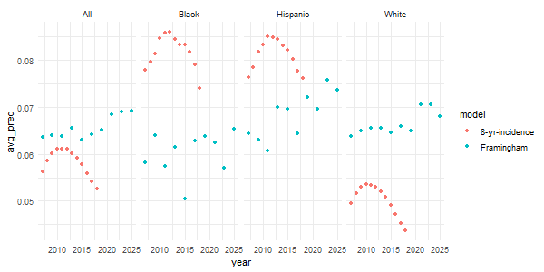
Framingham

Slide 7
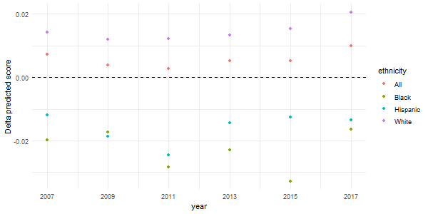
Framingham

Slide 8
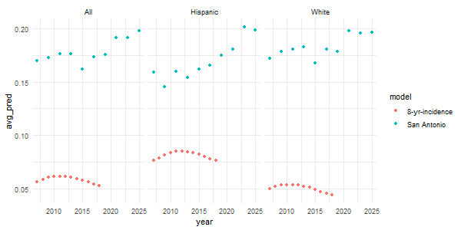
San Antonio

Slide 9
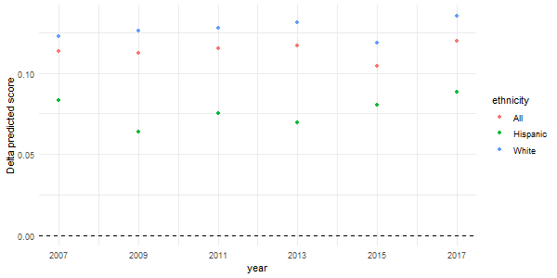
San Antonio

Slide 10
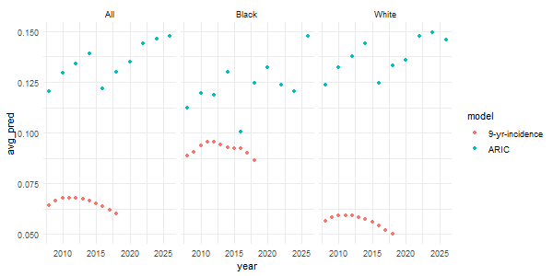
ARIC

Slide 11
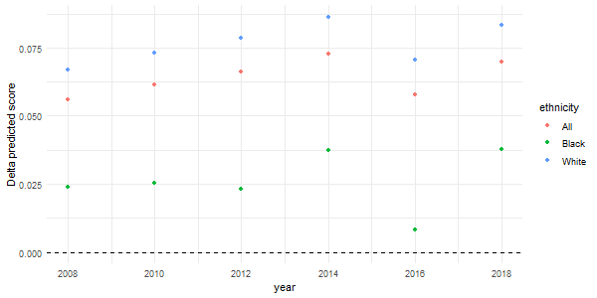
ARIC

Slide 12
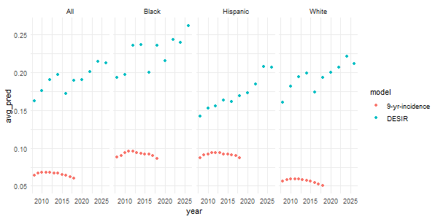
DESIR

Slide 13
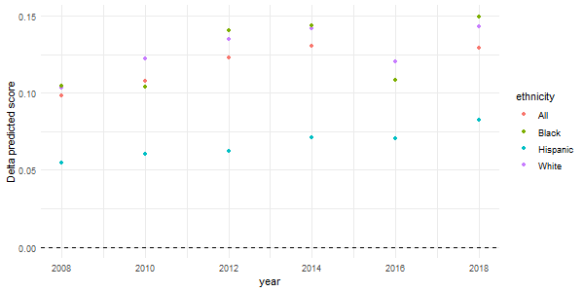
DESIR

Slide 14
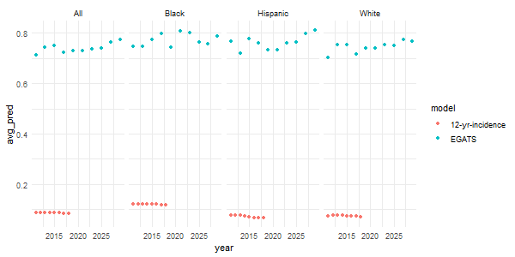
EGATS

Slide 15
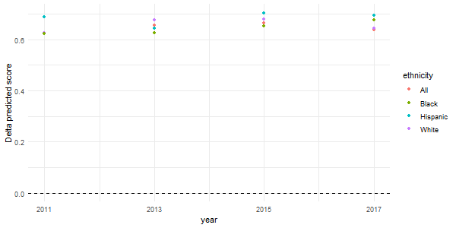
EGATS

